Slide 1

Financial Analytics:
Product wise sales report
Gross monthly total sales report
Gross yearly total sales report
Market badge report
Sales Analytics:
Top n customers by net sales for a given year
Top n products by net sales for a given year
Top n markets by net sales for a given year
Customers Net sales % shares in global market
Region wise Net sales % shares in global market
Top n products in each division by their sold quantity
Top n markets in every region by their gross sales amount
Supply Chain Analytics:
Forecast accuracy for all customers for a given fiscal year
Customer’s whose forecast accuracy has dropped from 2020 to 2021

Slide 2

Thakur Prem Singh
I have 3 YOE in IT industry and Currently working At TCS (Jan-2025)
thakurpremsingh153@gmail.com
https://www.linkedin.com/in/thakur-prem-singh-61943715a

Slide 3
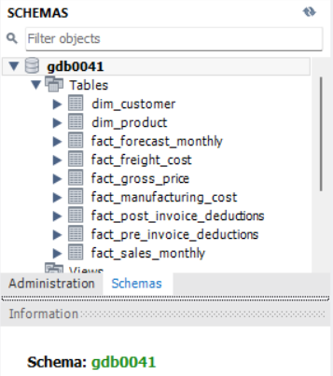
Financial Analytics:
Product wise sales report of Croma India for fiscal year 2021
Gross monthly total sales report for Croma India
Gross yearly total sales report for Croma India
Market badge based on sold quantity

Slide 4
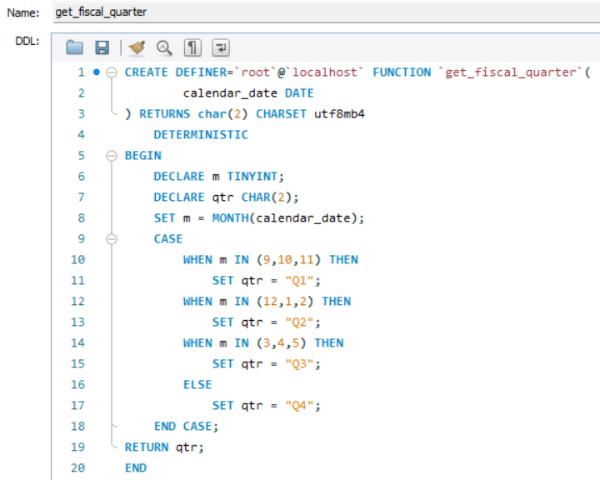
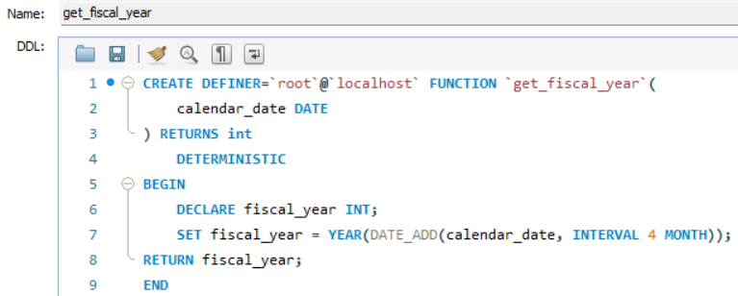
Function To Get Fiscal Quarter
Function To Get Fiscal Year

Slide 5
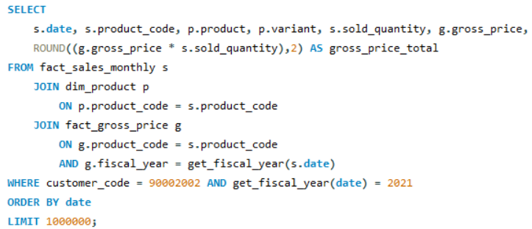
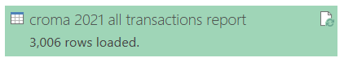
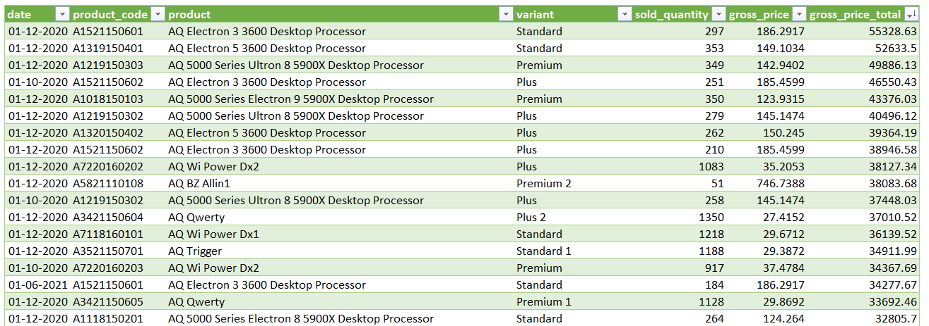
Product wise sales report of Croma India for fiscal year 2021

Slide 6
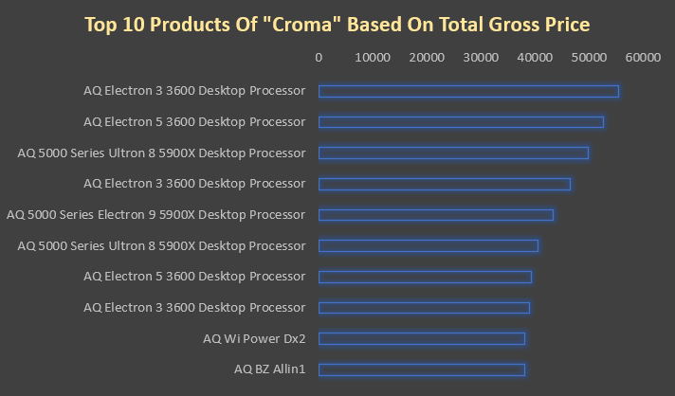
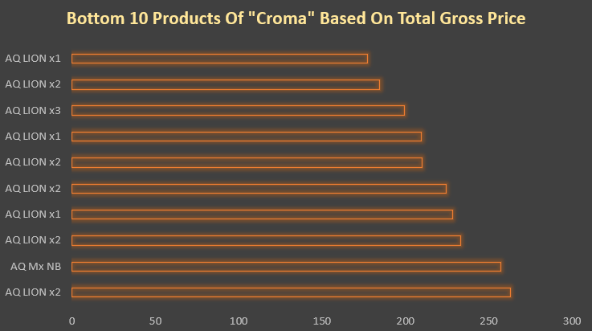
Top / Bottom 10 product of Croma India based on total gross price for fiscal year 2021

Slide 7
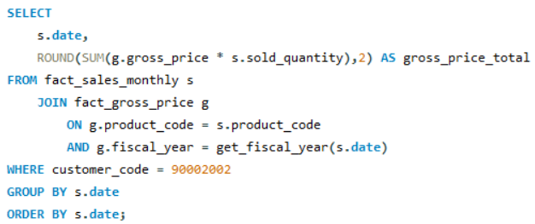

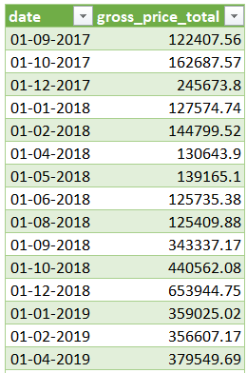
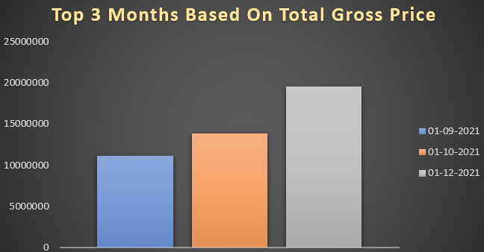
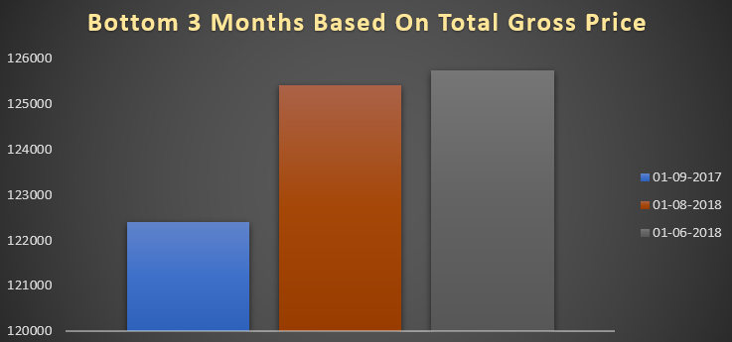
Gross monthly total sales report for Croma India

Slide 8
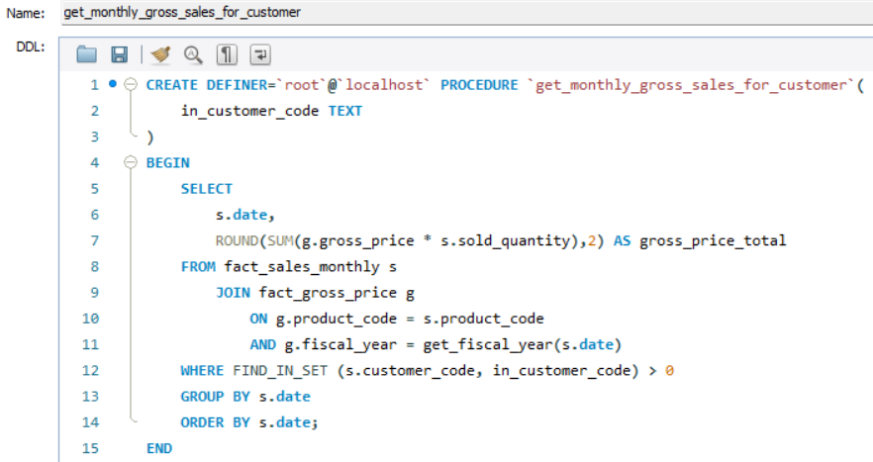
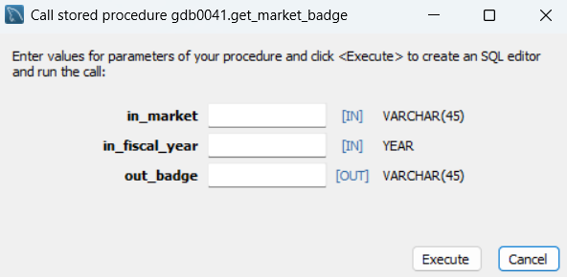
Stored Procedure to get gross monthly total sales report

Slide 9
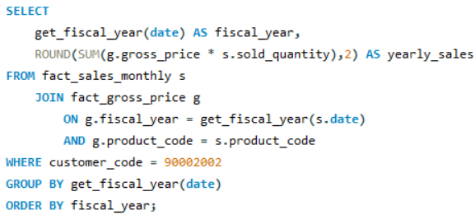

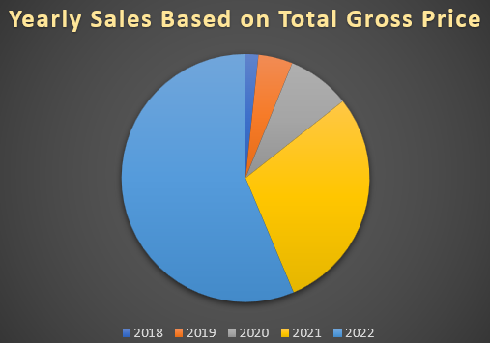
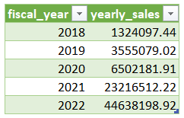
Gross yearly total sales report for Croma India

Slide 10
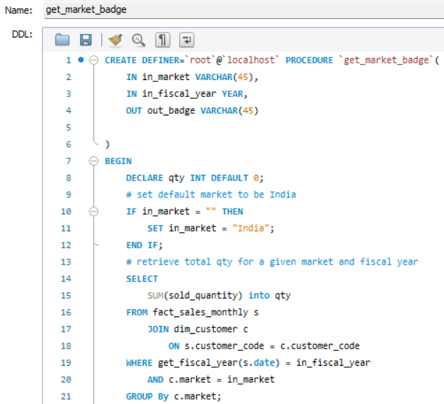
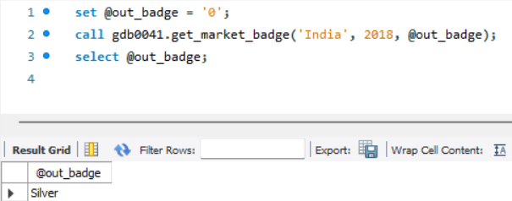
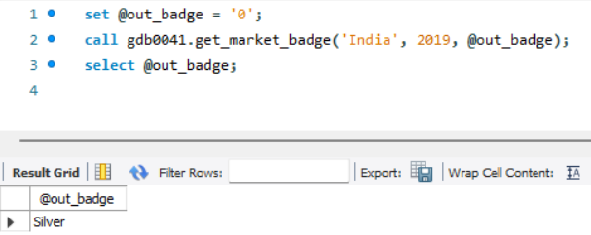
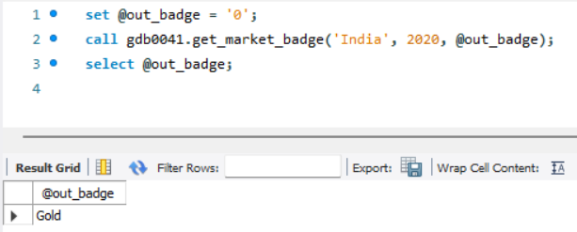
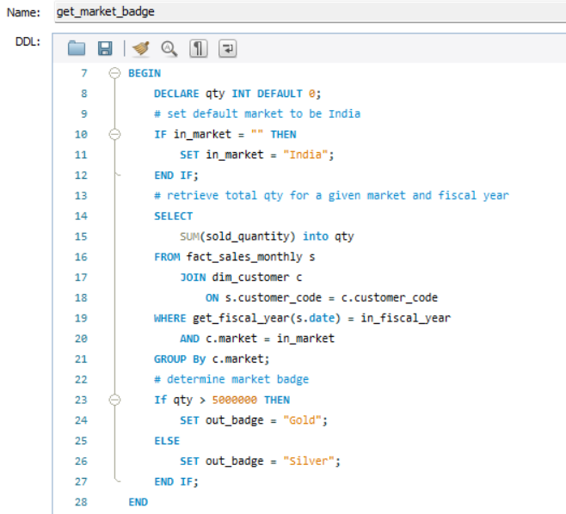
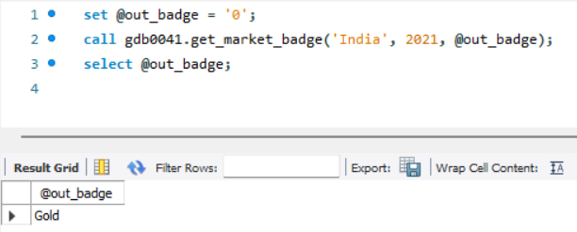
Market badge based on sold quantity
2018 & 2019 India is Silver
2020 & 2021 India is Gold

Slide 11
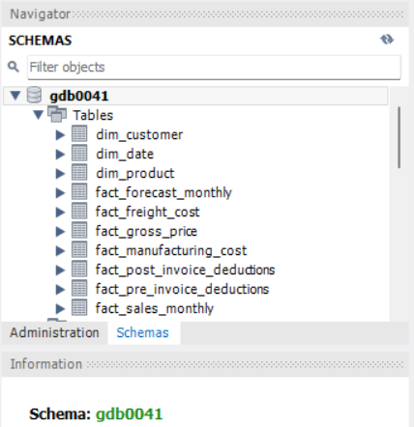
Sales Analytics:
Top n customers by net sales for a given year
Top n products by net sales for a given year
Top n markets by net sales for a given year
Customers Net sales % shares in global market
Region wise Net sales % shares in global market
Top n products in each division by their sold quantity
Top n markets in every region by their gross sales amount

Slide 12
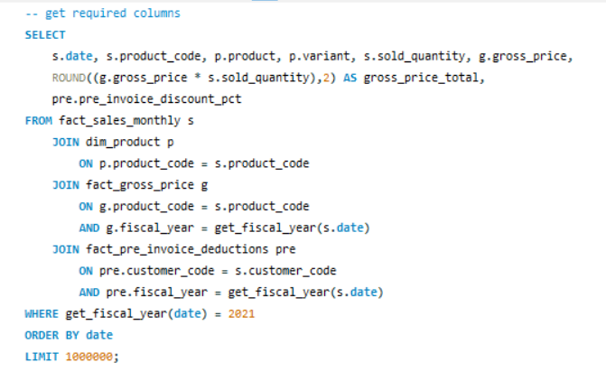
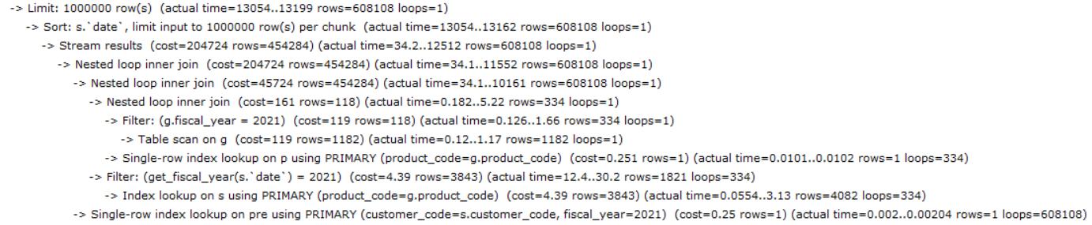
Net sales are revenue of the company
Gross price
Net invoice sale = gross price – pre invoice deduction
Net sales = Net invoice sale – Post invoice deductions
Gross margin = Net sales - COGS
Pre-invoice deductions (yearly discount agreements revised every financial year)
Post-invoice deductions = Promotional offers + placement fees + performance rebate
COGS (cost of goods sold) = manufacturing + freight + other

Slide 13
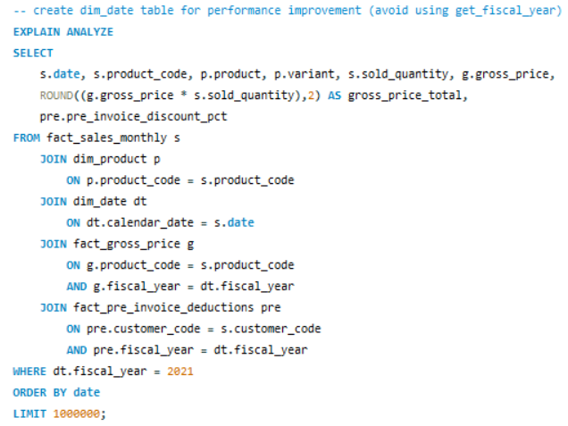
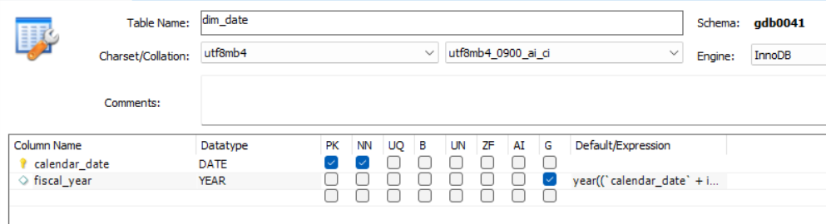
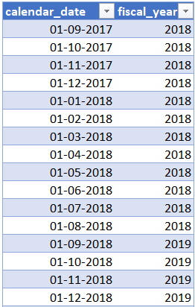
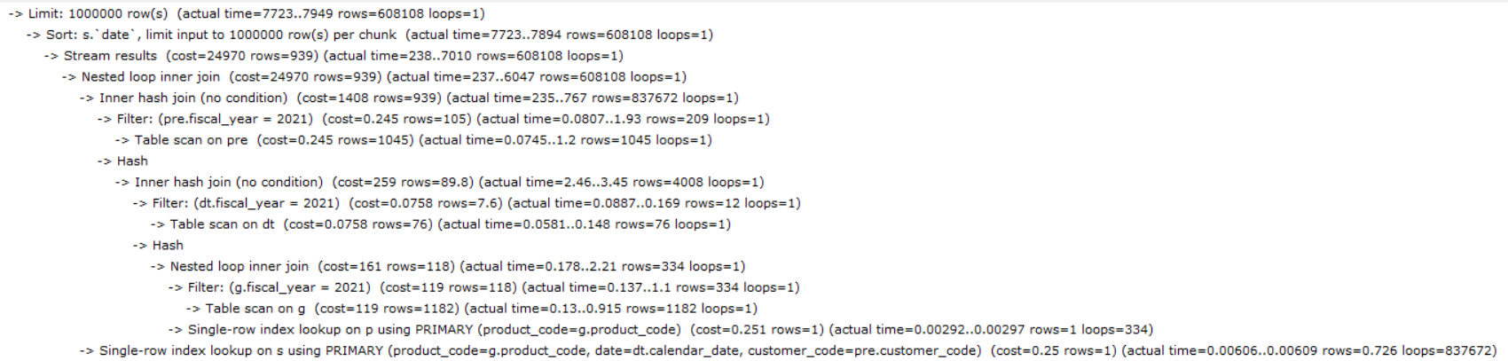
Performance improvement : create dim_date table(avoid using get_fiscal_year)
Generated column :
YEAR(DATE_ADD(calendar_date, INTERVAL 4 MONTH))

Slide 14
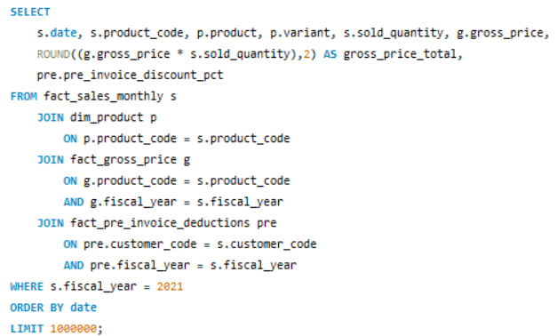
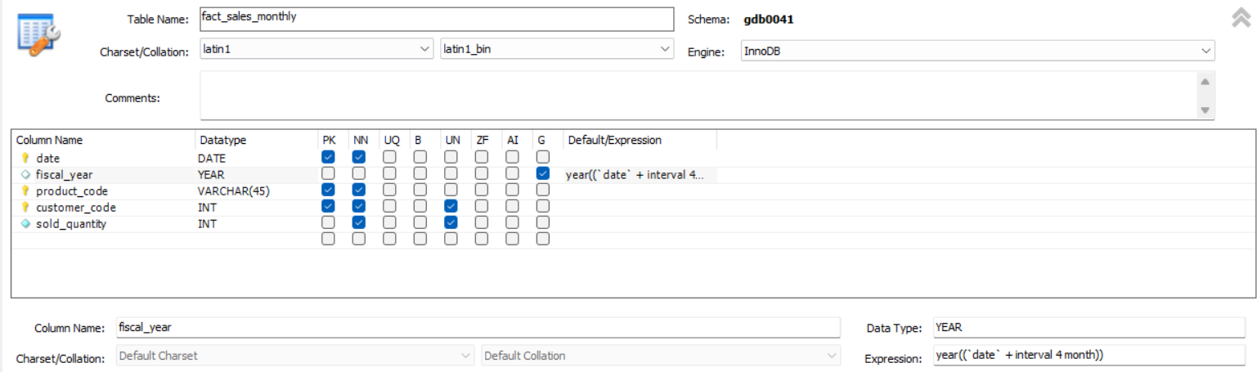
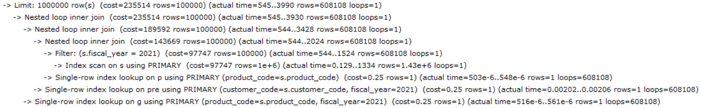
Performance improvement : create fiscal_year column in fact_sales_monthly table

Slide 15
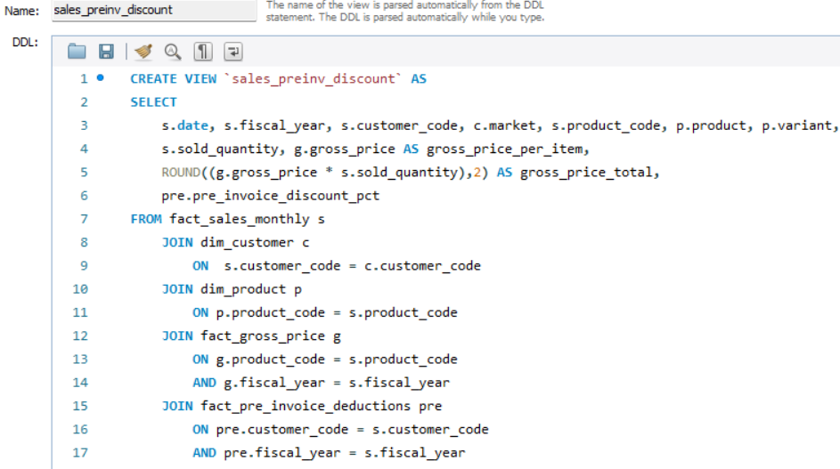
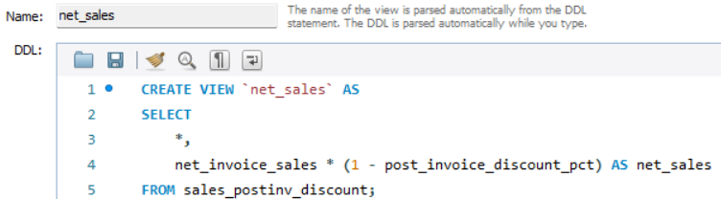
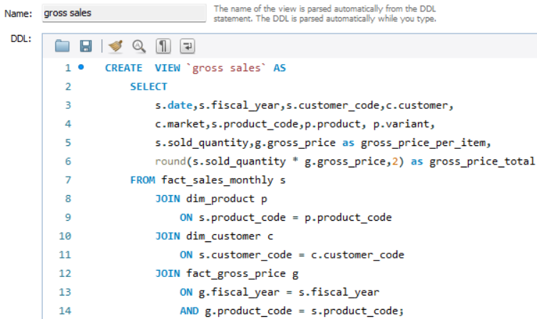
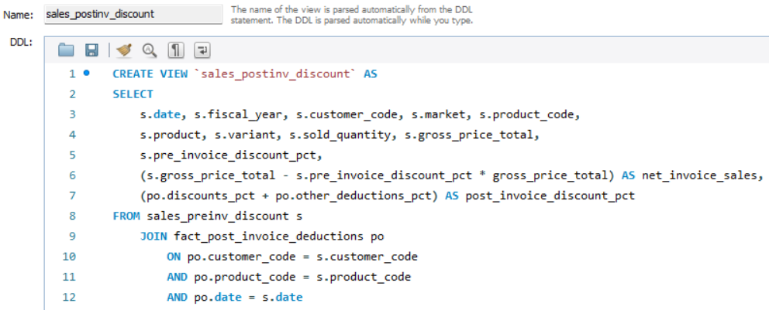
VIEWS (virtual table)

Slide 16

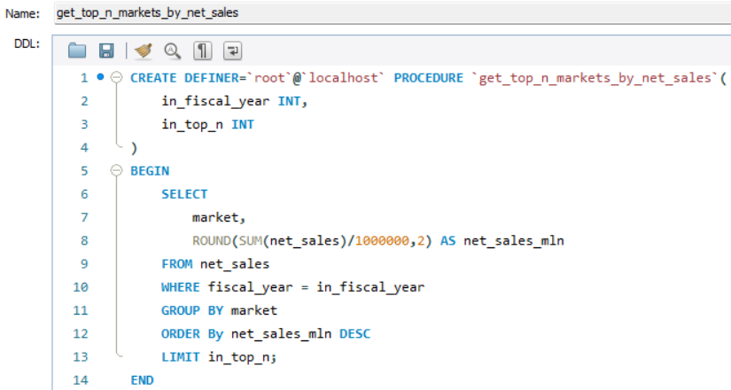
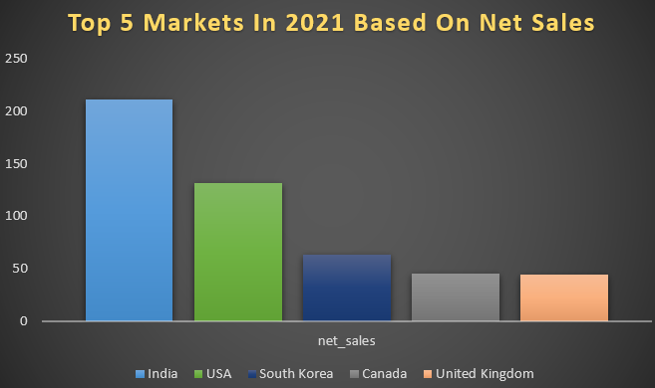
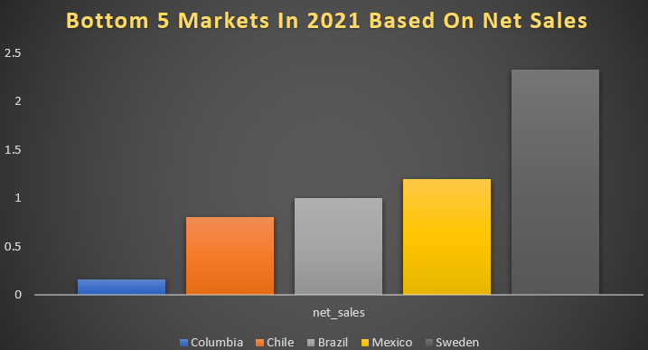
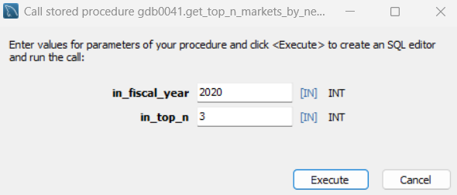
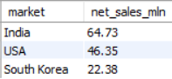
Top n markets by net sales for a given year

Slide 17
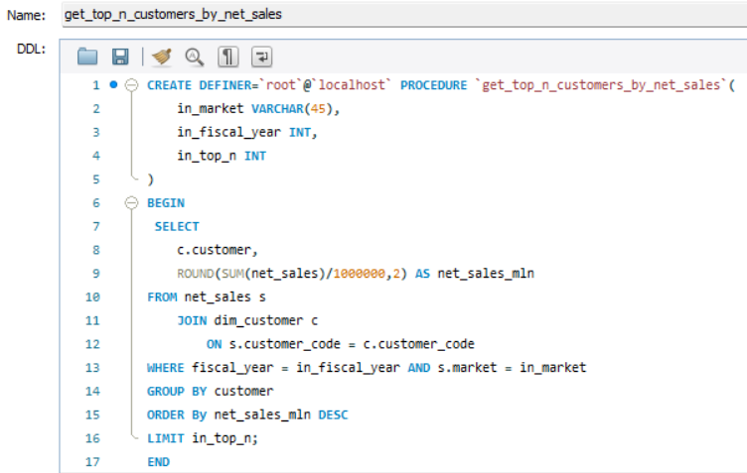
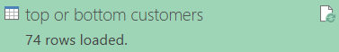
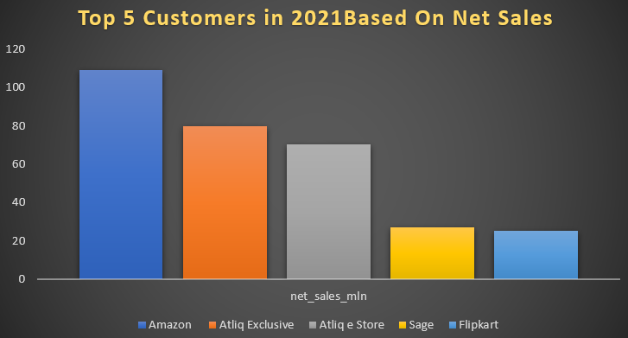
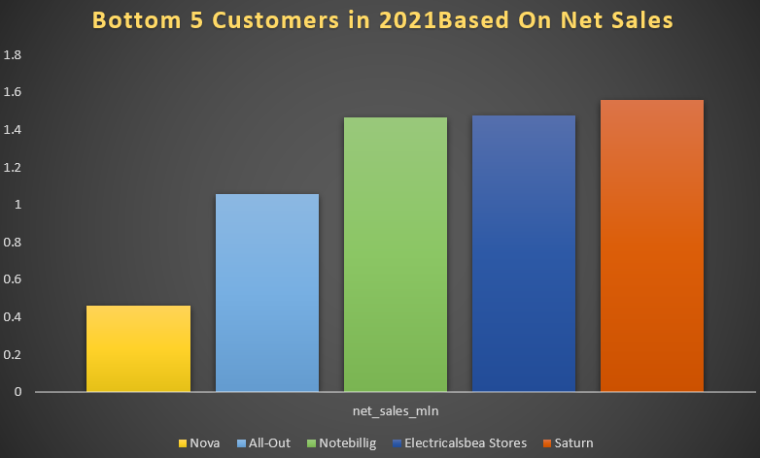
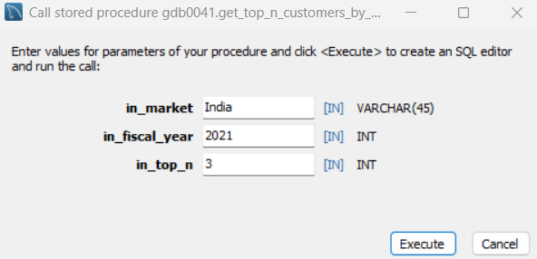
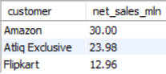
Top n customers by net sales for a given year

Slide 18
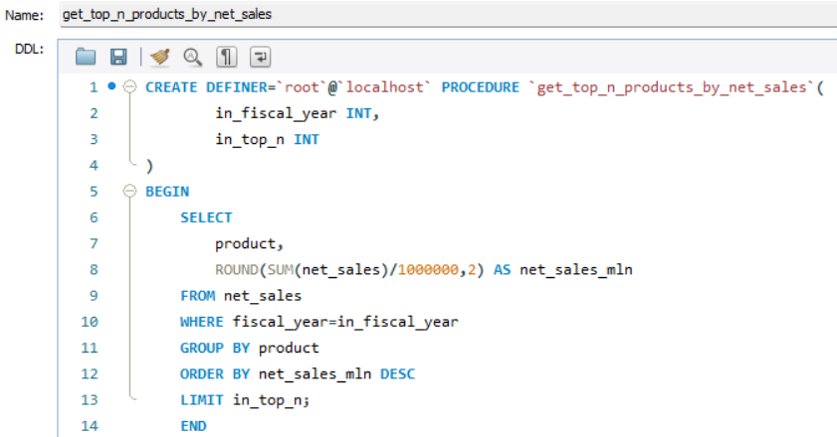
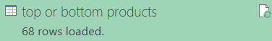




Top n products by net sales for a given year

Slide 19




Customers Net sales % shares in global market

Slide 20






Region wise Net sales % shares in global market

Slide 21







Top n products in each division by their sold quantity

Slide 22







Top n markets in every region by their gross sales amount

Slide 23

Supply Chain Analytics:
Forecast accuracy for all customers for a given fiscal year
Customer’s whose forecast accuracy has dropped from 2020 to 2021

Slide 24




Created a Helper Table that has both sold quantity and forecast quantity

Slide 25


Created Triggers (auto - updating)

Slide 26

VIEWS: beyond the session
STORED PROCEDURES: output parameters
FUNCTIONS: no output parameters
SUB QUERY: single value
CTE: scope of statement
TEMPORARY TABLES: scope of entire session

Slide 27





Forecast accuracy for all customers for a given fiscal year

Slide 28





Customer’s whose forecast accuracy has dropped from 2020 to 2021

Slide 29

THANK YOU
thakurpremsingh153@gmail.com

Slide 30
Financial Analytics
Sales Analytics
Supply Chain Analytics

